Slide 1

BLOOD LINK
A Web-Based Blood Donation Awareness System
College Project Presentation
Presented by: K.Mohana Priya, M.Sarayu, J.Pujitha, P.Spurna, P.Kiranmai
Department: Computer Engineering
College: Alwardas Polytechnic College

Slide 2
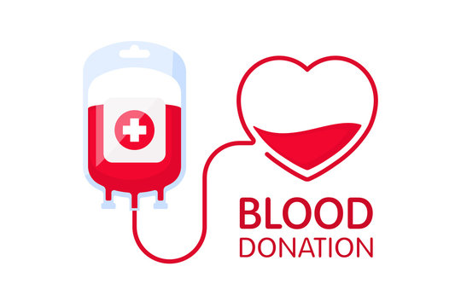
INTRODUCTION
Blood donation is an important way to help save lives.
Blood is needed for emergencies and medical treatment.
Finding suitable donors can sometimes be difficult.
Blood Link provides blood donation information through a website.
The website encourages people to learn about and participate in blood donation.
.
It aims to promote awareness, responsibility, and a culture of voluntary blood donation.
Finding suitable blood donors at the right time can sometimes be difficult, especially during
emergency.

Slide 3
PROBLEM STATEMENT
People may find it difficult to locate suitable blood donors quickly.
Donor information may be scattered across different sources.
People may not know the steps involved in donating blood.
A simple and organised website can help people access blood donation information

Slide 4






objectives
Develop a simple and use-friendly website.
Promote voluntary blood donation.
Explain the steps involved in blood donation.
Provide useful information and answers to common questions.
Encourage community participation.

Slide 5
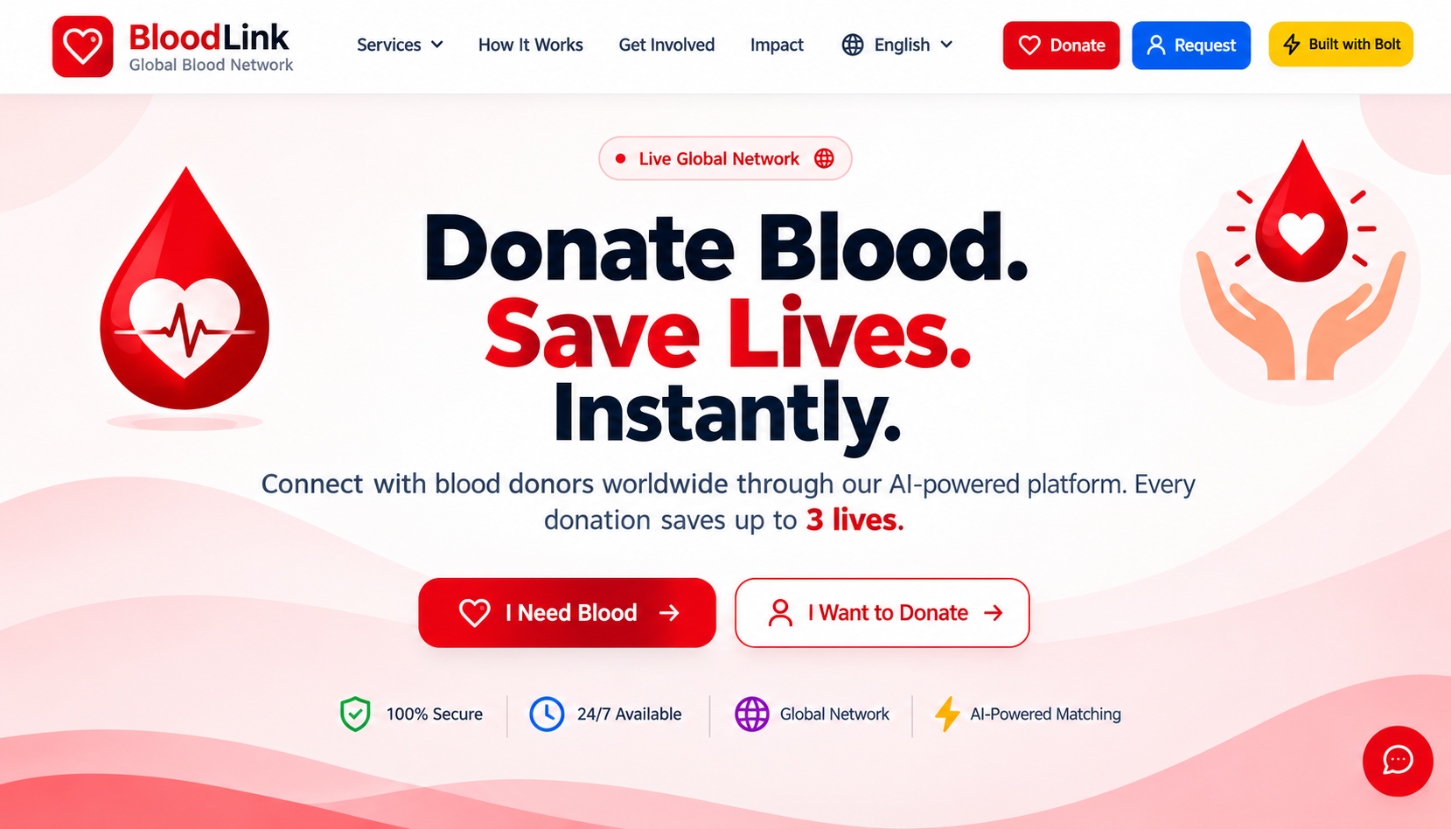

Slide 6
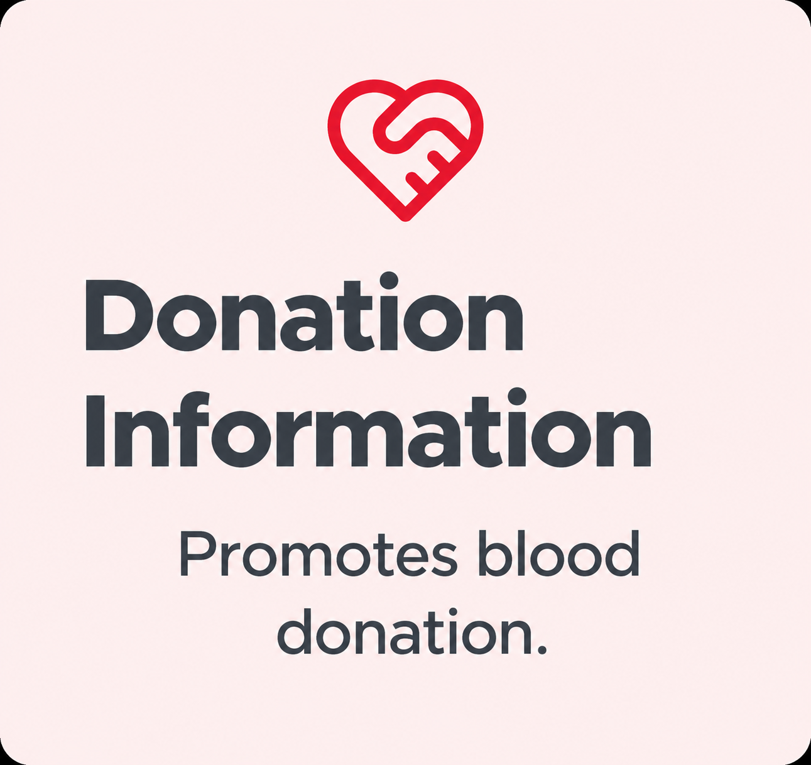
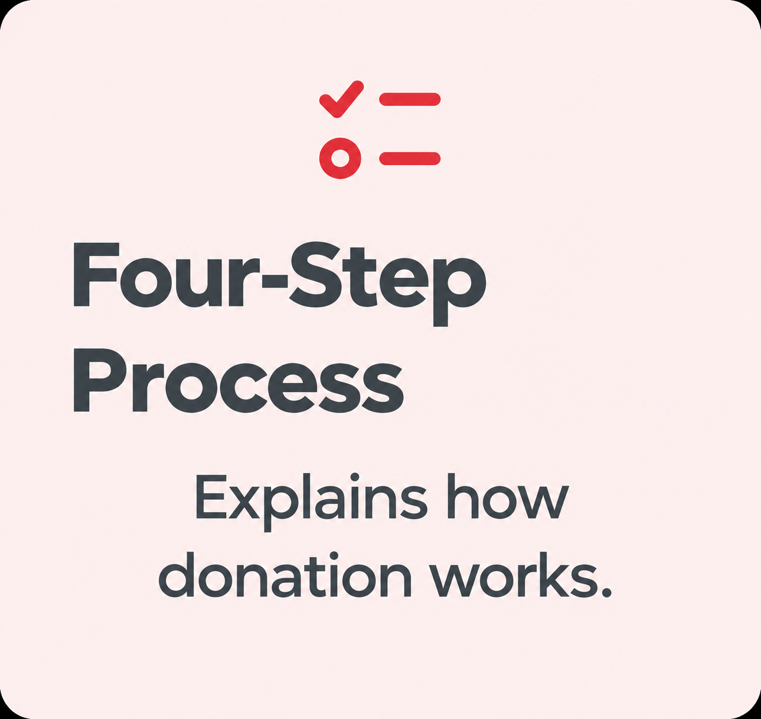
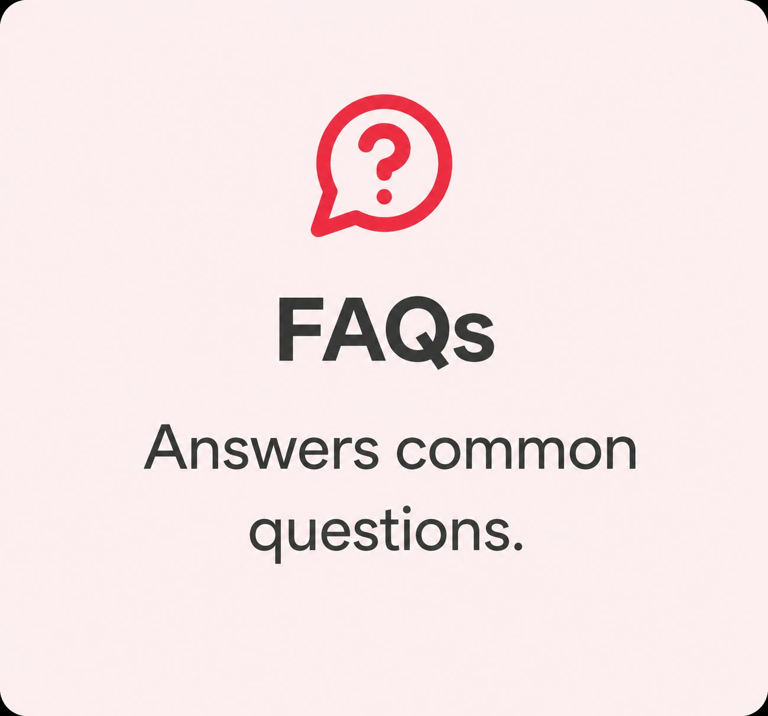

KEY FEATURES

Slide 7




HOW IT WORKS
Fill The Form
Enter the required registration information .
Get Verified
The proposed process includes an eligibility review .
Get Notified
Recieve updates about donation needs or appointments .
Donate Blood
Visit an appropriate donation center after eligibility is confirmed .

Slide 8
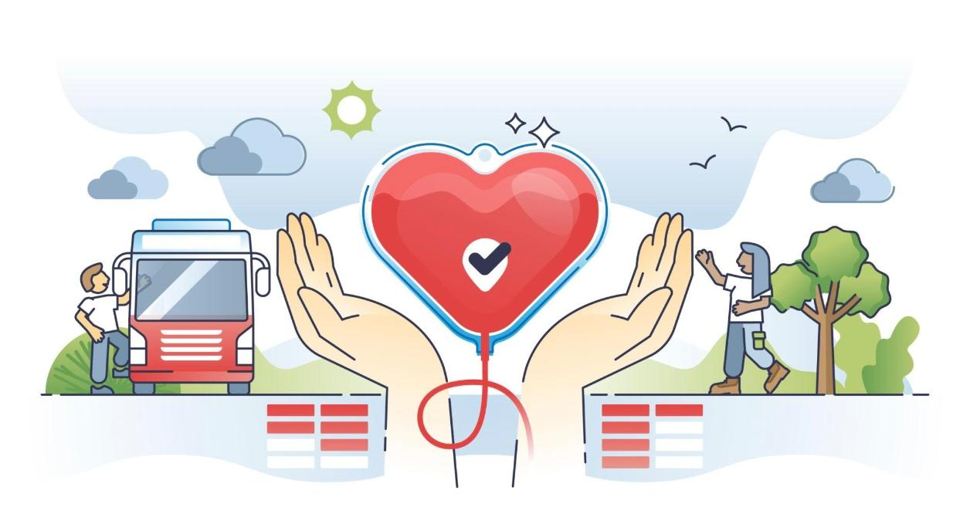
ADVANTAGES
Easy to access : Visotors can view information through a website .
Awareness : Encourages voluntary blood donation .
Guidance : Explains the donation process.
Convenience : Provides answers to common questions.
Community Support : Encourages people to help others.

Slide 9




FUTURE ENHANCEMENTS:
Verified Donor Search
Allow users to search verified donors by blood group and location.
Notifications
Send alerts for relevant donation requests.
Location-based search
Help users discover nearby verified donation centres or donors.
Improved Security
Protect personal information and verified donor details.

Slide 10
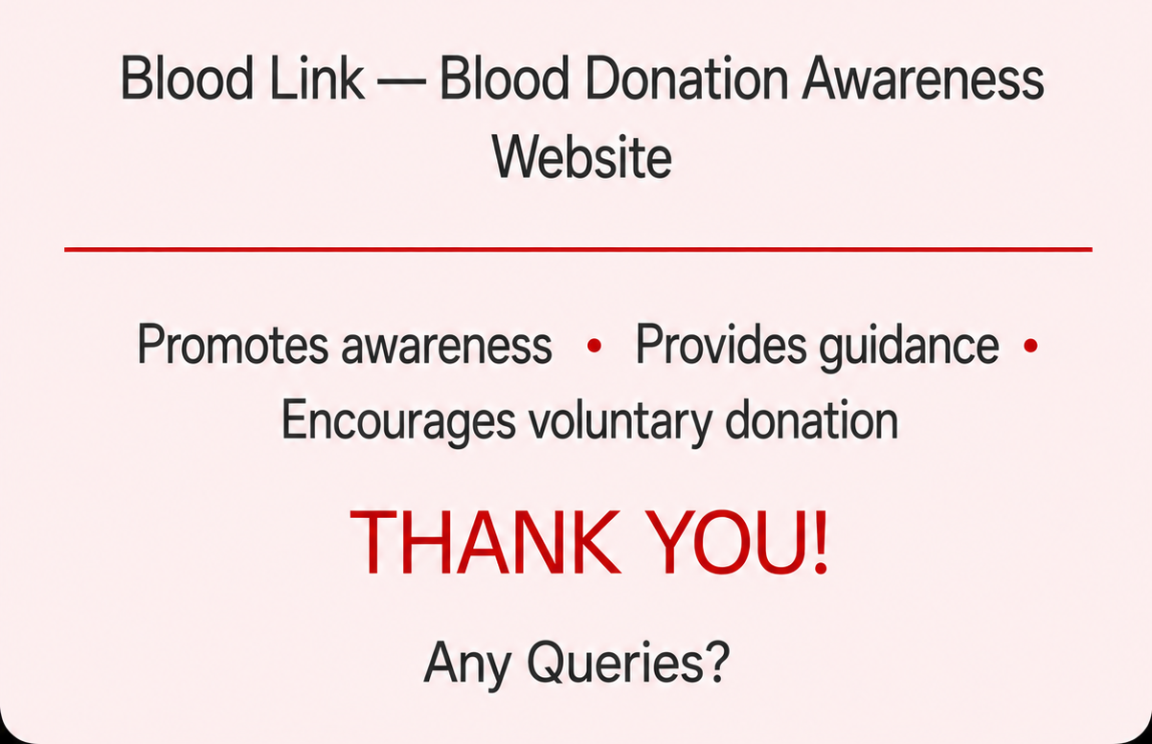
CONCLUSION

